Slide 1
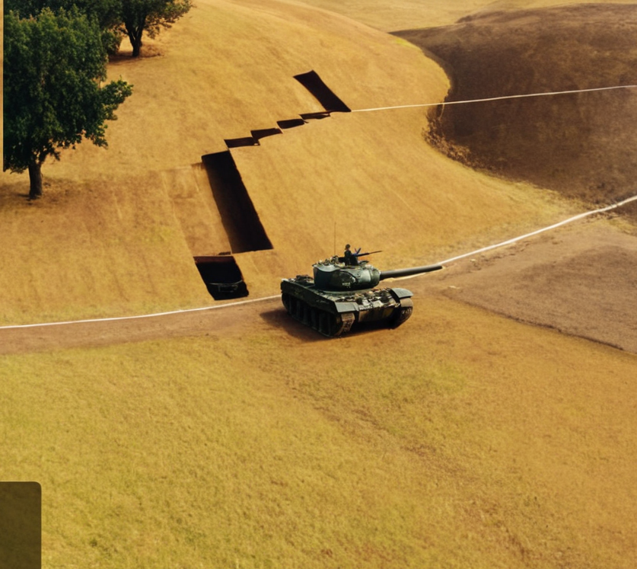
Ares Team
Tank wars
KORNEL
KRZYSZTOF
TITAS
OMNI

Slide 2
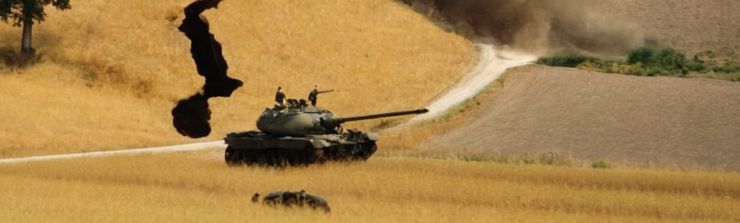
AI Techniques
FSM – Finite State Machine

Slide 3
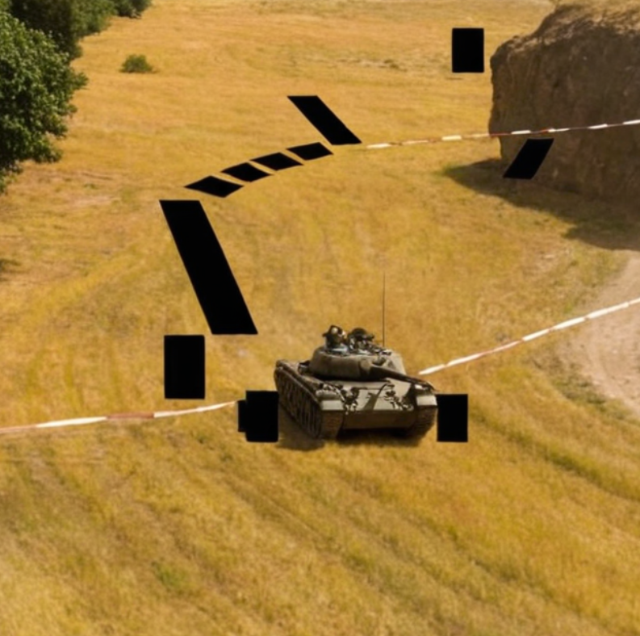
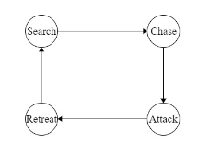
Intended behaviour
Aggressive Tank
Look for nearby enemies, if timeout
Attack bases or explore when no nearby enemies for longer time
Chance for retreat if when HP is low

Slide 4
FSM Stages
Search
Chase
Hide
Explore
Ambush
Wait
Attack
Retreat
No nearby enemies
Enemy spotted (far)
Close distance
Low HP

Slide 5
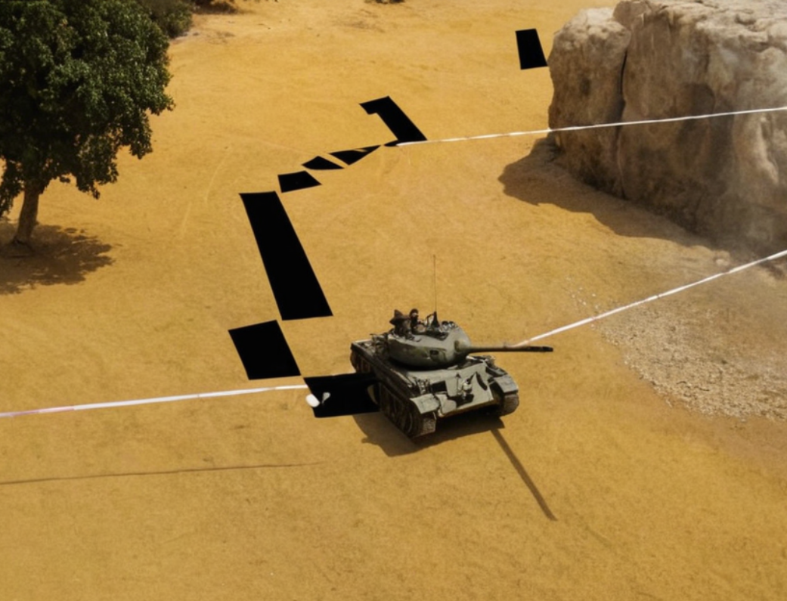
!!!!!! ! DELETE ME (LATER) ! !!!!!!
You can write about your theme here.
You can explain why you chose the theme.
The goal is to be light-hearted, playful, and funny

Slide 6
Add Video OR !!!!!! ! DELETE ME (LATER) ! !!!!!!

Slide 7
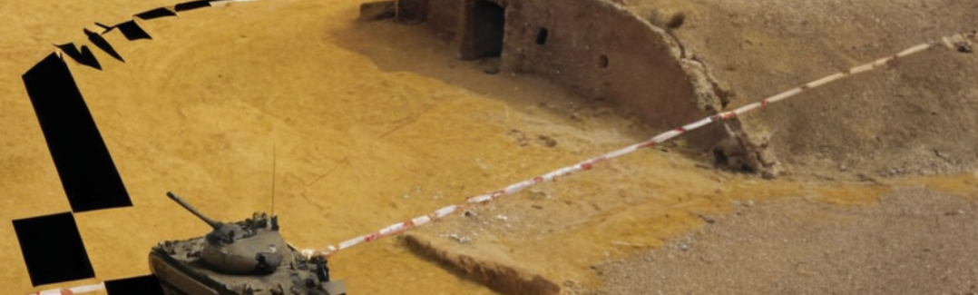
Something
!!!!!! ! DELETE ME (LATER) ! !!!!!!

Slide 8
!!!!!! ! DELETE ME (LATER) ! !!!!!!
Your theme can be anything you want. Here are some examples to start:
Explain why [subject] is your favourite film.
Teach about a famous person in history.
Introduce the group to your hidden talent.

